Slide 1



GROUP NAME: PS4
SUPRIYA SINHA
SALIL SHAILESH
PRIYANKA TAMBE
GORide: Optimizing Driver Strategy

Slide 2

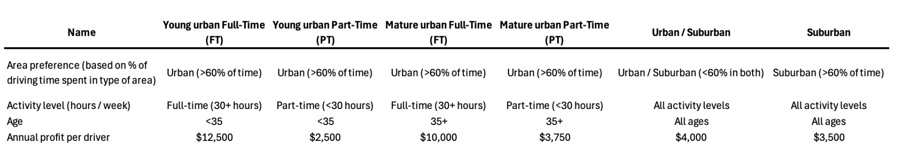

Decoding GORide’s Driver Landscape:
Who Delivers the Most Value?
Key Takeaways
- Young Urban FT & Mature Urban FT generate the highest profit per driver.
- Targeting these segments will maximize revenue & operational efficiency
- Lower-value segments (Suburban & Urban/Suburban) should receive minimal investment

Slide 3
Market Size & Activity Analysis

Slide 4
Where does GoRide lag behind its competitors?
1.
Response time (<1 hour)
GORide's rating: 2.0 (out of 7)
Competitor's rating: 5.5
“Addressing these service gaps will enhance
Retention
& Competitive Positioning”
2.
Issue resolution
GORide's rating: 3.0
Competitor's rating: 5.0
3.
Loyalty rewards
GORide's rating: 2.0
Competitor's rating: 4.0

Slide 5
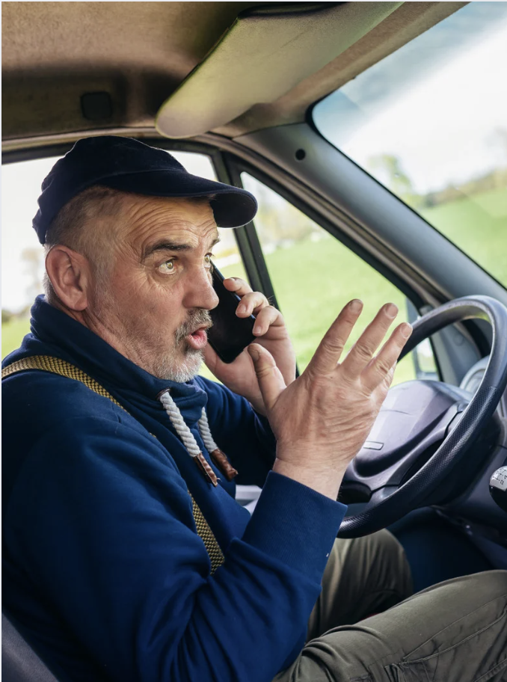
What Matters to the Drivers?
1.
Fast Issue Resolution
Quick resolution of payment issues, rider disputes, app glitches
Loyalty Rewards
Incentives (e.g., bonuses, reduced commission rates, exclusive benefits
2.
Quick Response Times
GORide’s low rating (2.0/7) on response times suggests that this is a major pain
3.
Flexible Policies for Drivers
policies that provide flexibility in scheduling, payouts, and penalties
4.

Slide 6

Service Enhancement Selection
1.
Expected to increase market share by
0.63%
Cost per driver: $55
Impact: Helps drivers get support and resolve problems more efficiently, reducing frustration.
Faster Issue Resolution

Slide 7

Service Enhancement Selection
2.
Expected to increase market share by
0.62%
Cost per driver: $20
Impact: Encourages driver retention by recognizing and rewarding consistent performers.
Loyalty
Rewards

Slide 8
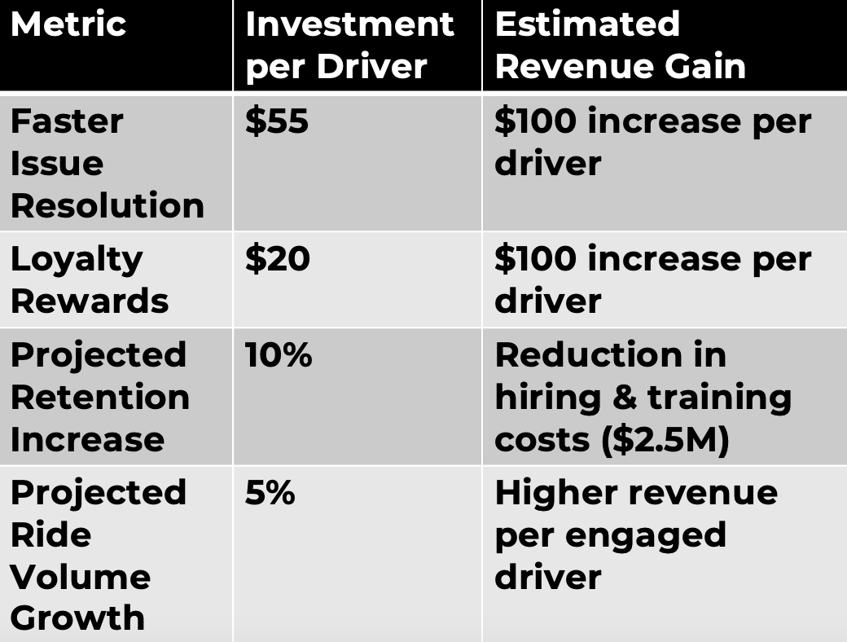
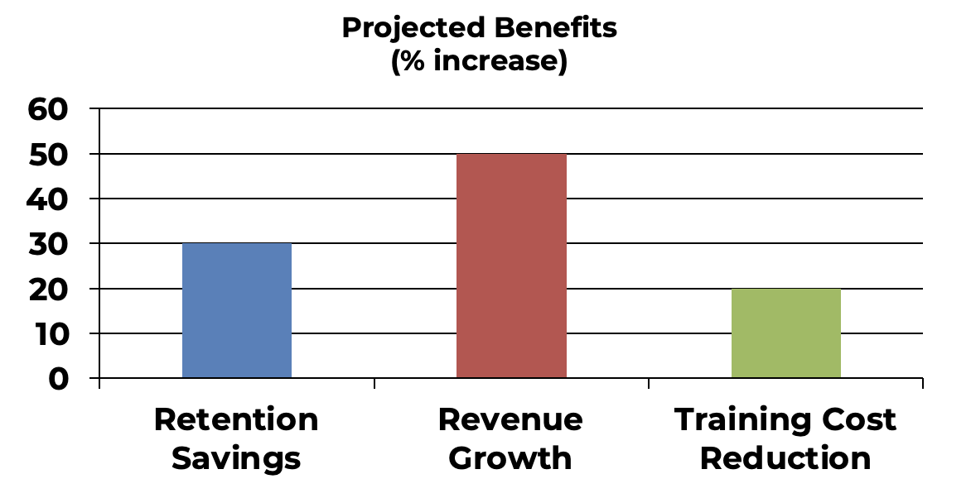
Financial Impact – Costs vs. Benefits

Slide 9
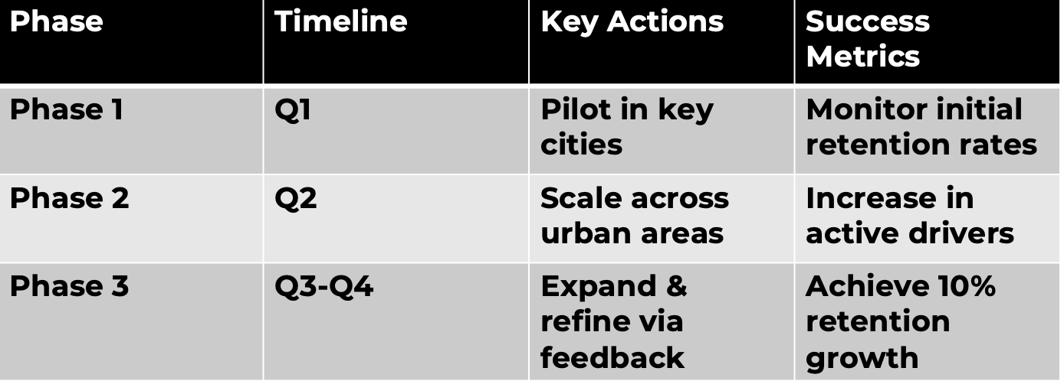
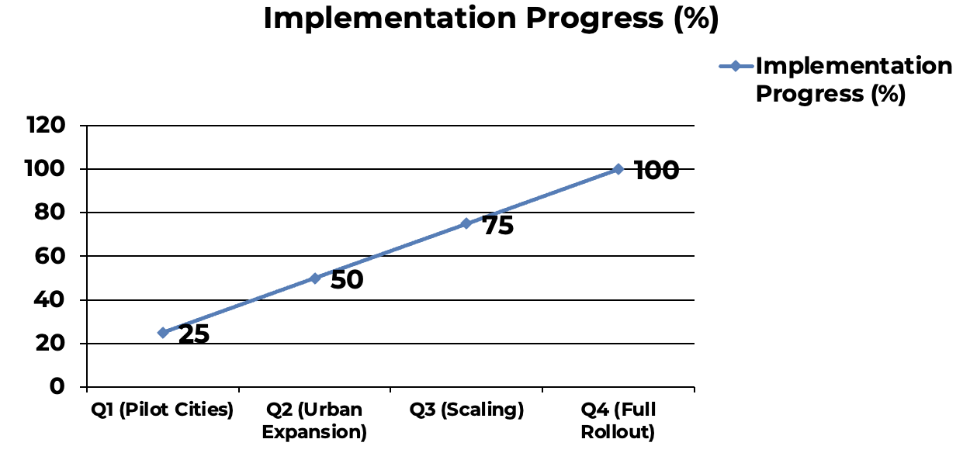
Implementation Roadmap

Slide 10

In Summary
Target Mature Urban FT & Young Urban FT for Differentiated Service
Implement Faster Issue Resolution & Loyalty Rewards
Projected Impact:
10% retention boost,
$2.5M hiring/training cost savings
"Investing in these enhancements will strengthen GORide’s driver base and reduce churn."

